Slide 1
Nashville Parks & Recreation Board Meeting April 2, 2024
Presentation by
The Alliance to Conserve Nashville’s Highland Rim Forest

Slide 2
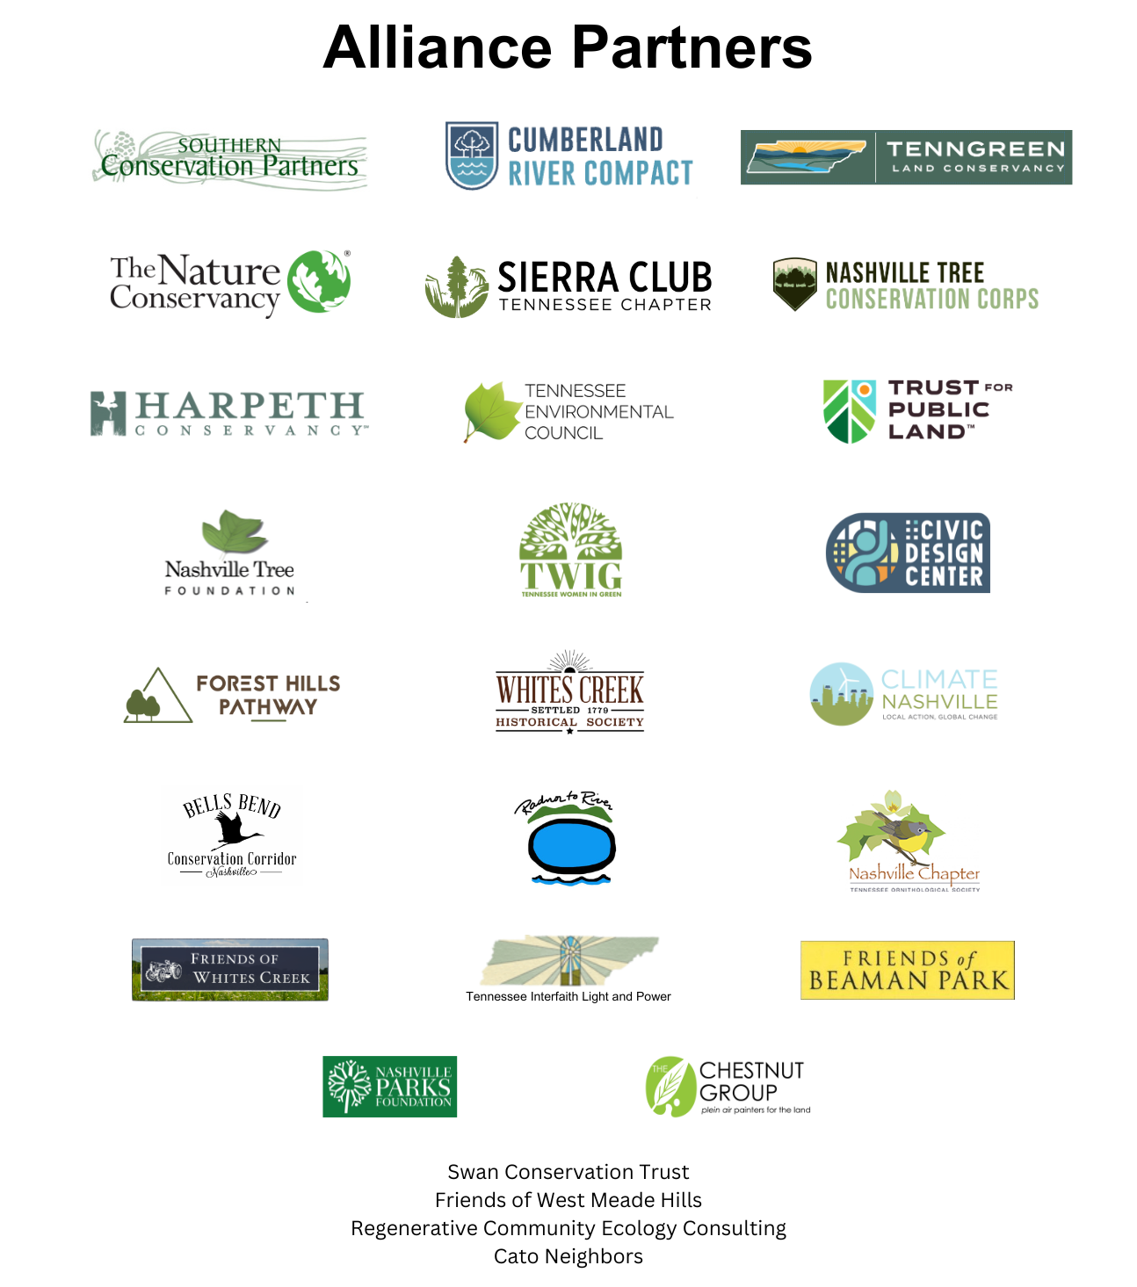

Slide 3
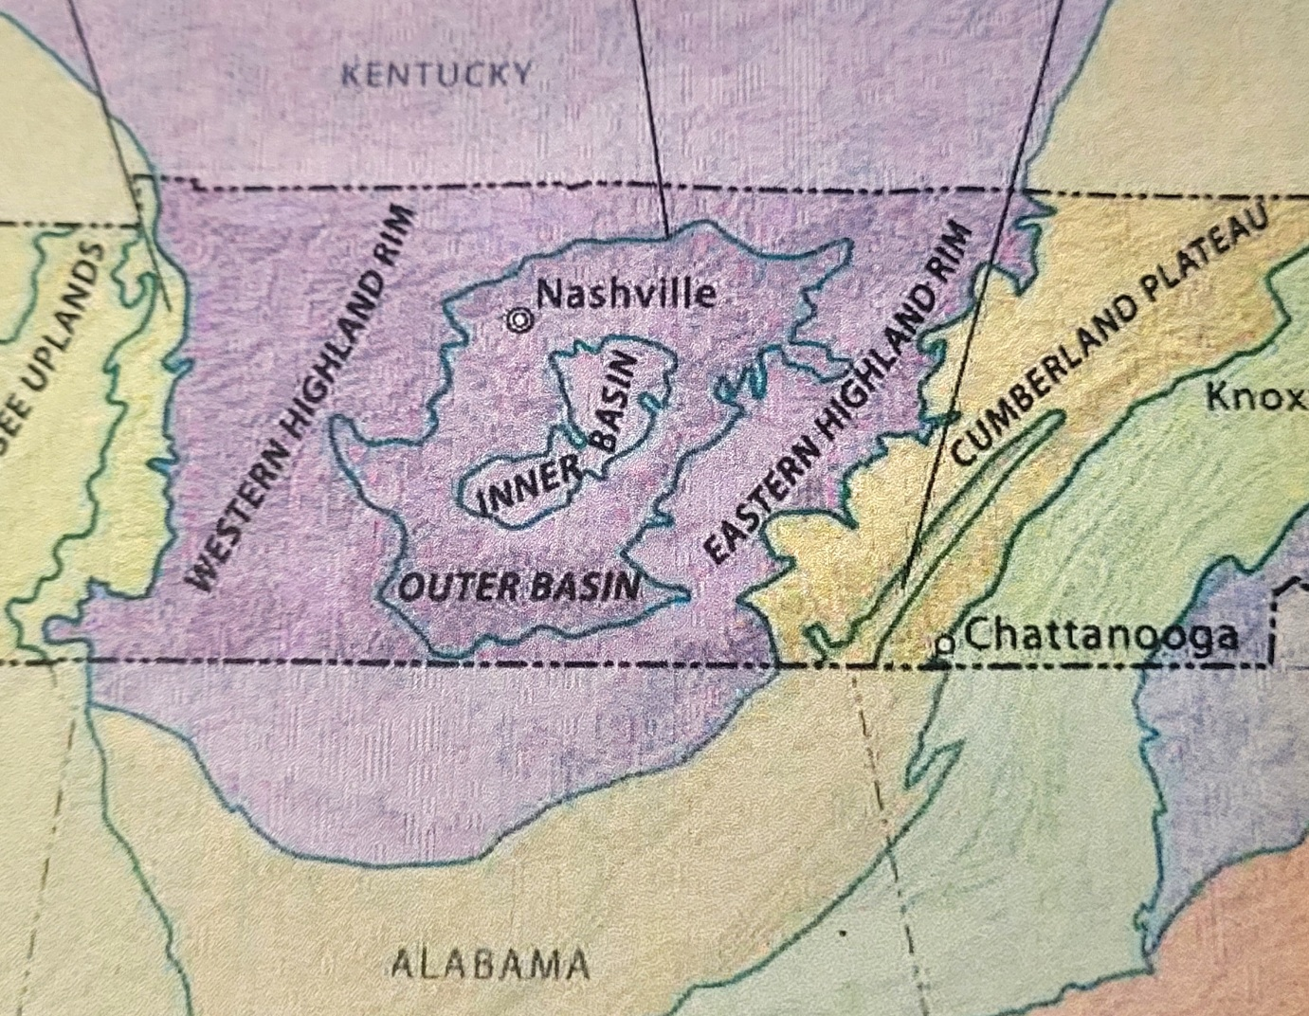

Slide 4
As mandated by Congress, in order to receive certain types of federal funding of conservation programs, TN completed a State Wildlife Action Plan (SWAP) in 2015. That plan contained a Conservation Opportunity Area known as the Western Highland Rim Forests.

Slide 5
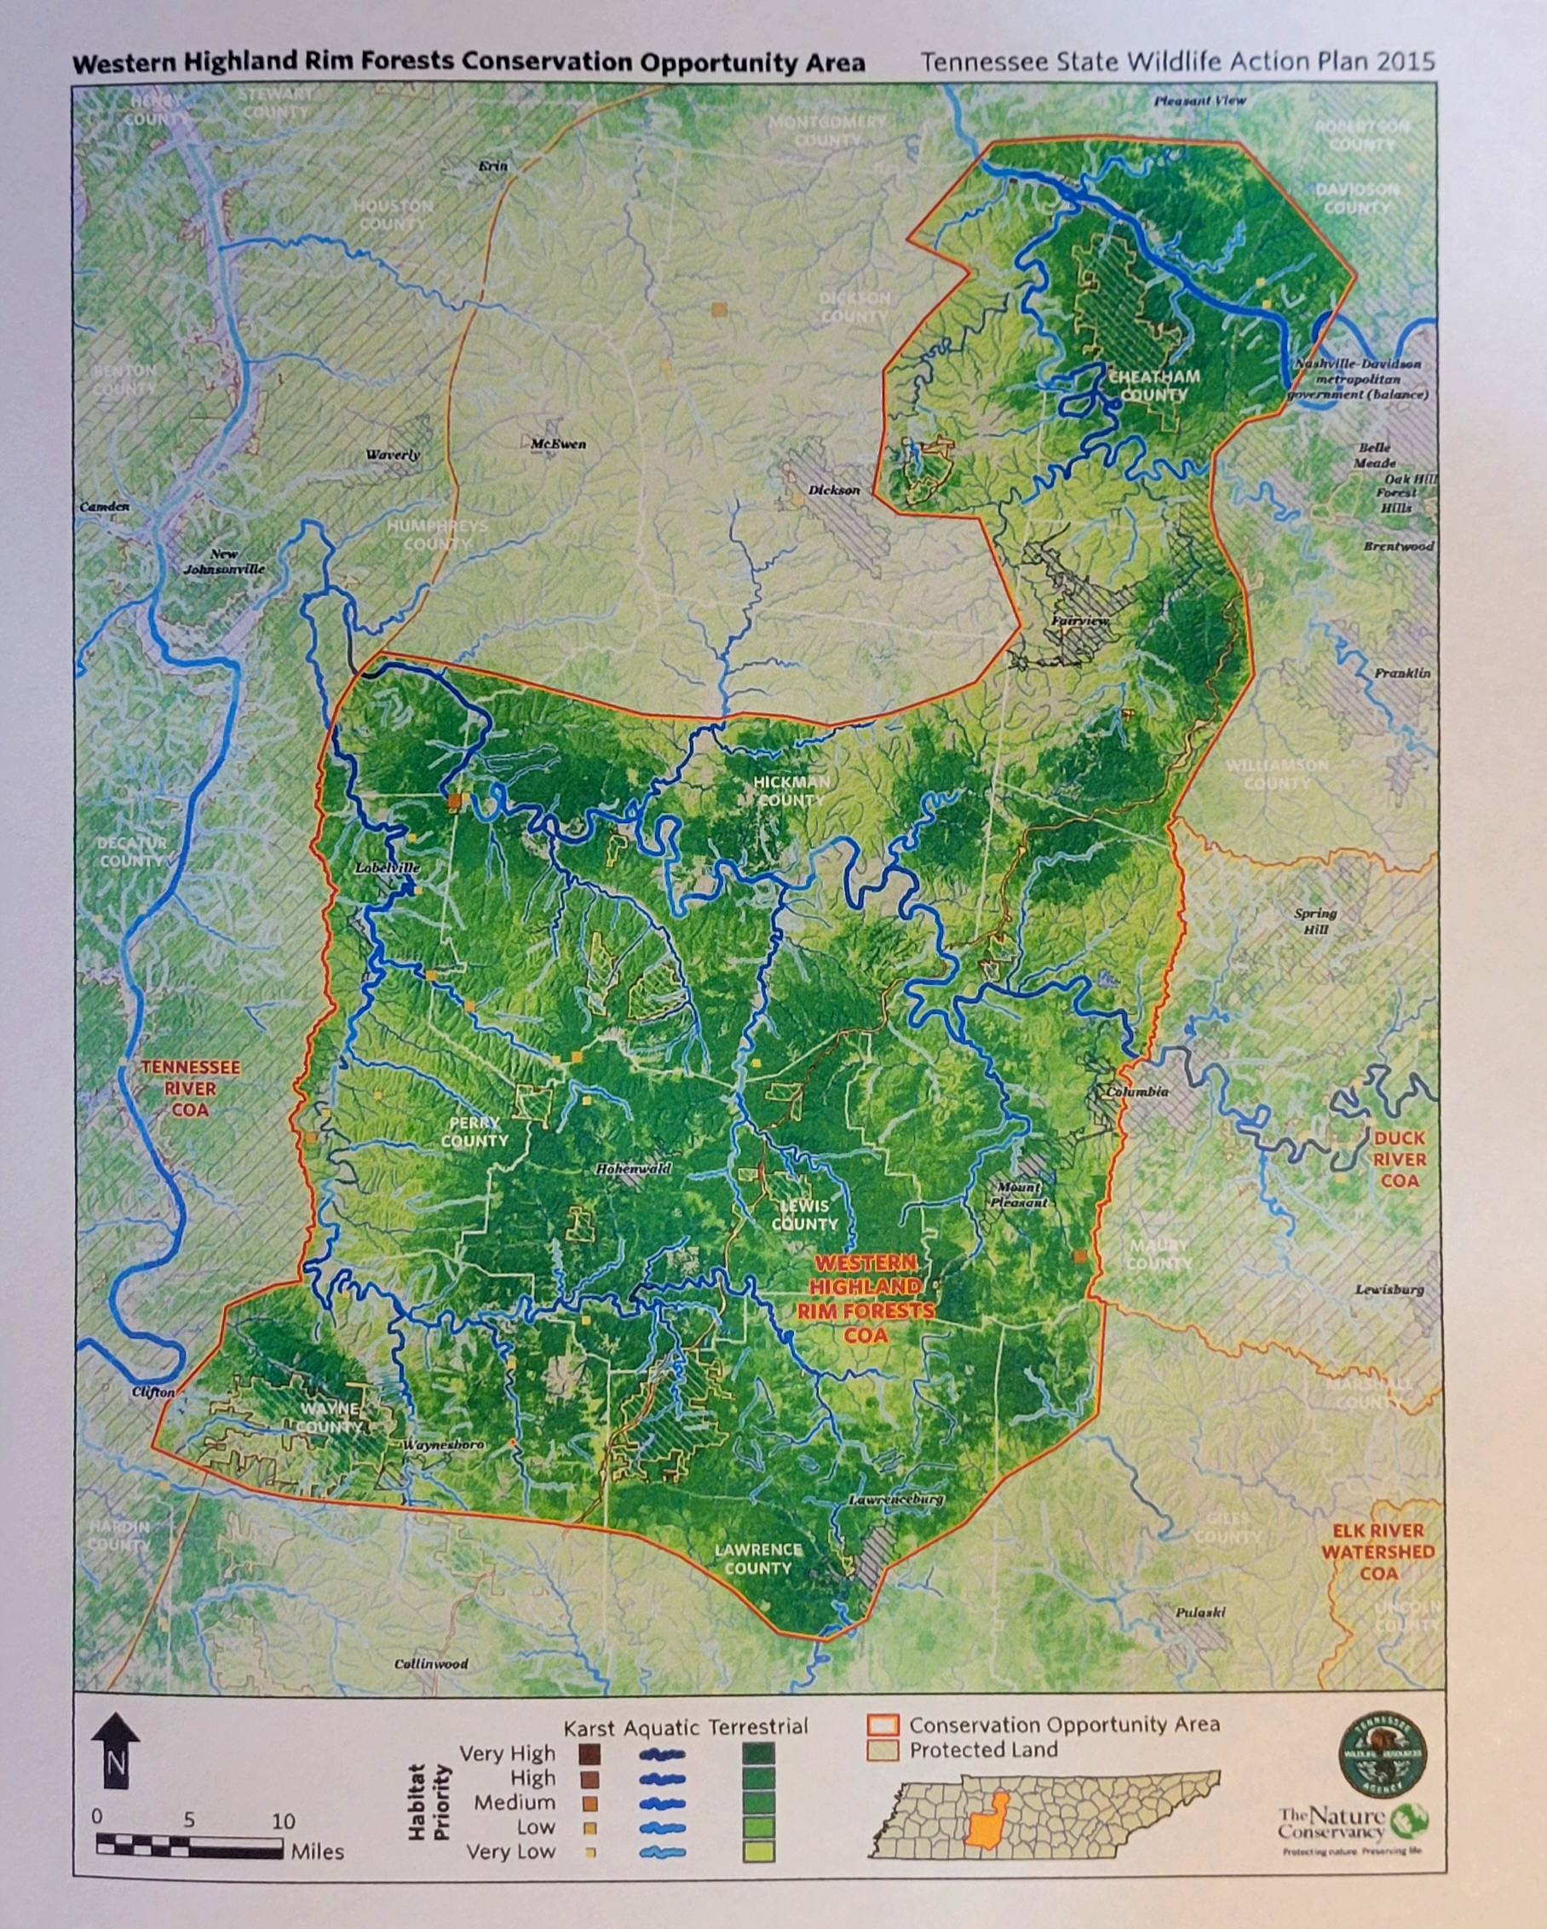

Slide 6
The Nature Conservancy (TNC) connected us to the resource group (Southeast Conservation Adaptation Strategy, SECAS) that uses objectively weighed, environmental data to help define the TN State Wildlife Action Plan (SWAP)
We worked with SECAS to refine the edges of the portion of the Western Highland Rim Forests that fell within Davidson County to have an objectively identified scope for the Nashville Highland Rim Forest.

Slide 7
Within Davidson County, Nashville’s Highland Rim Forest is the area with the most priorities in the Blueprint, meaning it is regionally significant across the Southeastern landscape.
92% of this area is within a Blueprint priority area (either Highest, High, or Medium priority, or a priority connection).
53% of the area is in either the Highest or High category.

Slide 8
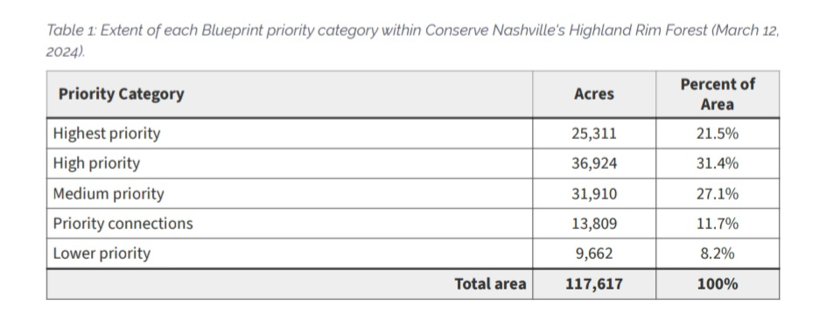

Slide 9
Comparative research indicates this single, continuous swath of woodlands is THE largest forest contained within the boundaries of any global city over 500k.
The world’s largest urban forest within any major city.

Slide 11
Our hope today - To have Metro Parks & Recreation recognize the 90,000+ forested acres of the Western Highland Rim and Outer Basin ecoregions that lie within Davidson County as Nashville’s Highland Rim Forest, and to support policy that recognizes the resources within this area as worthy of Conservation efforts as a part of the overall strategy in the planning and development of Nashville.

Slide 12
Specifically, we encourage two things:
1. That any revision to “Plan to Play” include “Nashville’s Highland Rim Forest” (NHRF) as a named and identifiable resource holding long term value in offering recreational, conservation & resilience, and health benefits to all living in the Midstate area.
That the Metro Parks website organize the trio of NHRF parks (Beaman, Bells Bend, Warner) under the logo the Music City Center created in order to showcase the aggregated amenities offered in the 3 parks. This branding builds Nashville’s “Green” mindset and creates a context in which these urban parks serve as hubs around which future Greenway and wildlife corridors might be networked and expanded.

Slide 13
Metro Park area and trails within the Nashville Highland Rim Forest in Davidson County.
[note: a small portion of Warner Parks extends into Williamson Co.]
Park | Owner | Area (ac) | Total trails: paved and unpaved (mi) | Unpaved footpaths (mi) | Paved pedestrian roadways (mi) | Mountain Bike Trails (mi) | Bridle paths, horse and pedestrian trails (mi)
Warner Parks^ | Metro | 3,112 | 65* | 17 | 21.4 | 8 | 18&
Beaman Park | Metro | 2,256 | 15 | 15 | na | na | na
Bells Bend Park | Metro | 808 | 6.0 | 6.0 | na | na | na
TOTAL |  | 6,176 | 86 | 38 | 21.4 | 8 | 18

Slide 14
