Slide 1
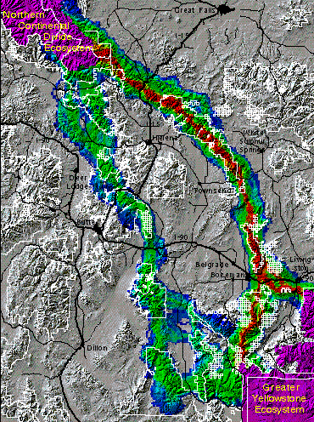
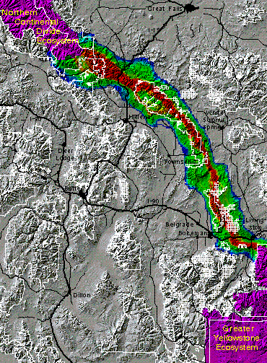
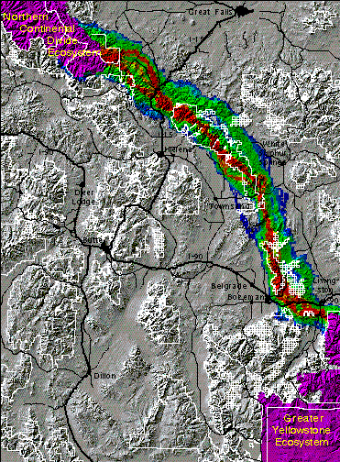
Analyzing Wildlife Movement Corridors in Montana Using GIS - 1996 ESRI Users Conference
Richard Walker and Lance Craighead
Grizzly Bear
Cougar
Elk

Slide 2
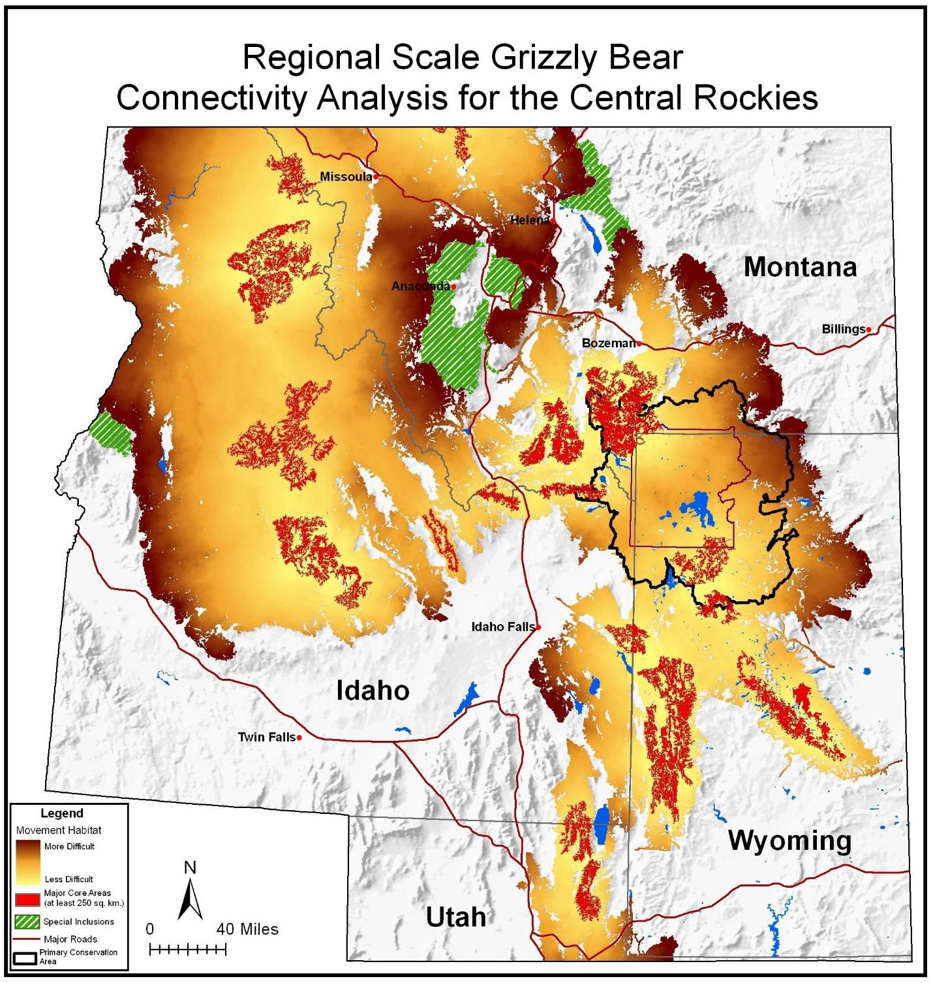
Wilderness, Wildlife, and Ecological Values
of the Hyalite-Porcupine-Buffalo Horn
Wilderness Study Area
A Report for the Lee and Donna Metcalf Foundation
By The Craighead Institute
Frank Lance Craighead, PhD November 2015

Slide 3
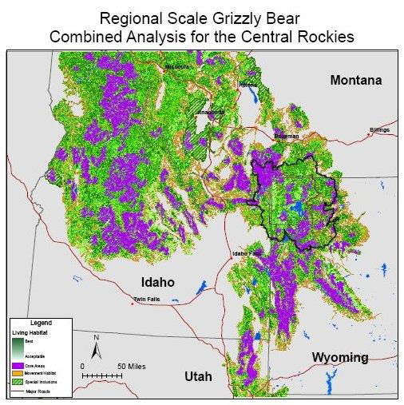

Slide 4
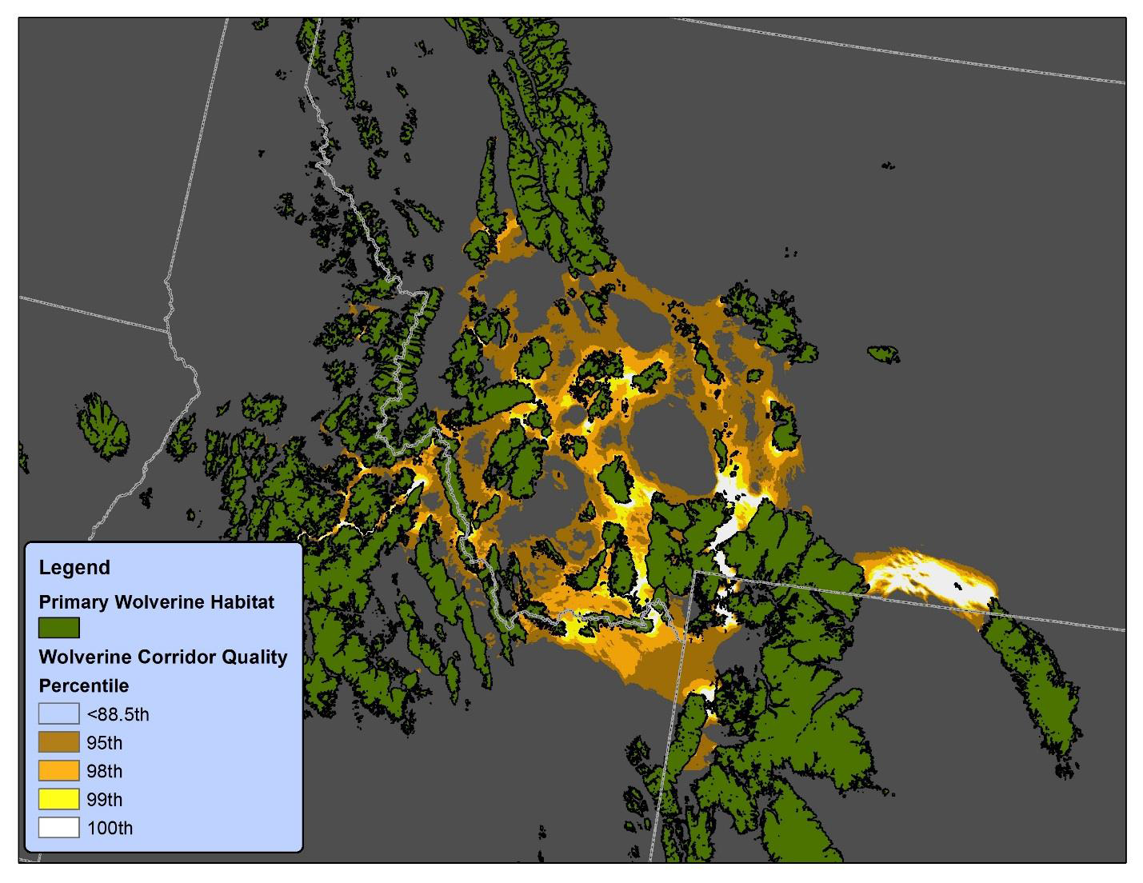

Slide 5
Potential paths for male-mediated gene flow to and from an
isolated grizzly bear population - 2017
CHRISTOPHER P. PECK,1,4 FRANK T. VAN MANEN,1, CECILY M. COSTELLO,2 MARK A. HAROLDSON,1
LISA A. LANDENBURGER,1 LORI L. ROBERTS,2 DANIEL D. BJORNLIE,3
AND RICHARD D. MACE
2
1Interagency Grizzly Bear Study Team, Northern Rocky Mountain Science Center, U.S. Geological Survey,
2327 University Way, Suite 2, Bozeman, Montana 59715 USA
2Montana Department of Fish, Wildlife and Parks, 490 North Meridian Road, Kalispell, Montana 59901 USA
3Large Carnivore Section, Wyoming Game and Fish Department, 260 Buena Vista, Lander, Wyoming 82520 USA
Citation: Peck, C. P., F. T. van Manen, C. M. Costello, M. A. Haroldson, L. A. Landenburger, L. L. Roberts, D. D. Bjornlie,
and R. D. Mace. 2017. Potential paths for male-mediated gene flow to and from an isolated grizzly bear population.
Ecosphere 8(10):e01969. 10.1002/ecs2.1969.

Slide 6
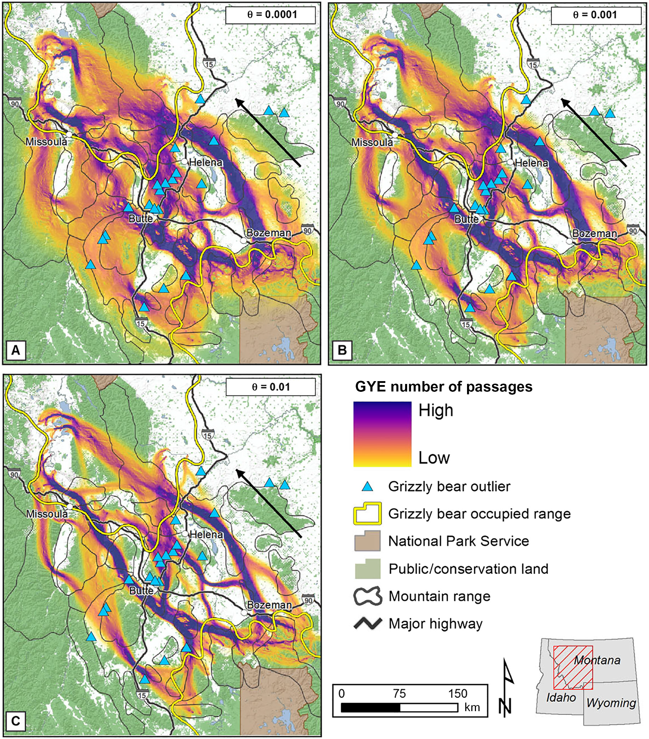
Fig. 3. Randomized shortest path (RSP) predictions of male
grizzly bear movements from the Greater Yellowstone
Ecosystem (GYE) to the Northern Continental Divide
Ecosystem (NCDE) based on GPS movement data
for males monitored in the GYE, 2000–2015. Color gradient
is based on cumulative values of RSPs for 100 pairs
of origin–destination nodes, representing the average
number of net passages for each grid cell. Three levels of h
are shown, representing different trade-offs between
exploration and optimal exploitation of the landscape:
(A)h = 0.0001, (B) h = 0.001, and (C) h = 0.01.
Locations of 21 confirmed records of grizzly bear presence
are shown as blue triangles. Black arrow indicates direction
of paths. Occupied range based on data through 2014
(Bjornlie et al. 2014, Costello et al. 2016).
❖ www.esajournals.org 10 October 2017 ❖
Volume 8(10) ❖ Article e01969

Slide 7
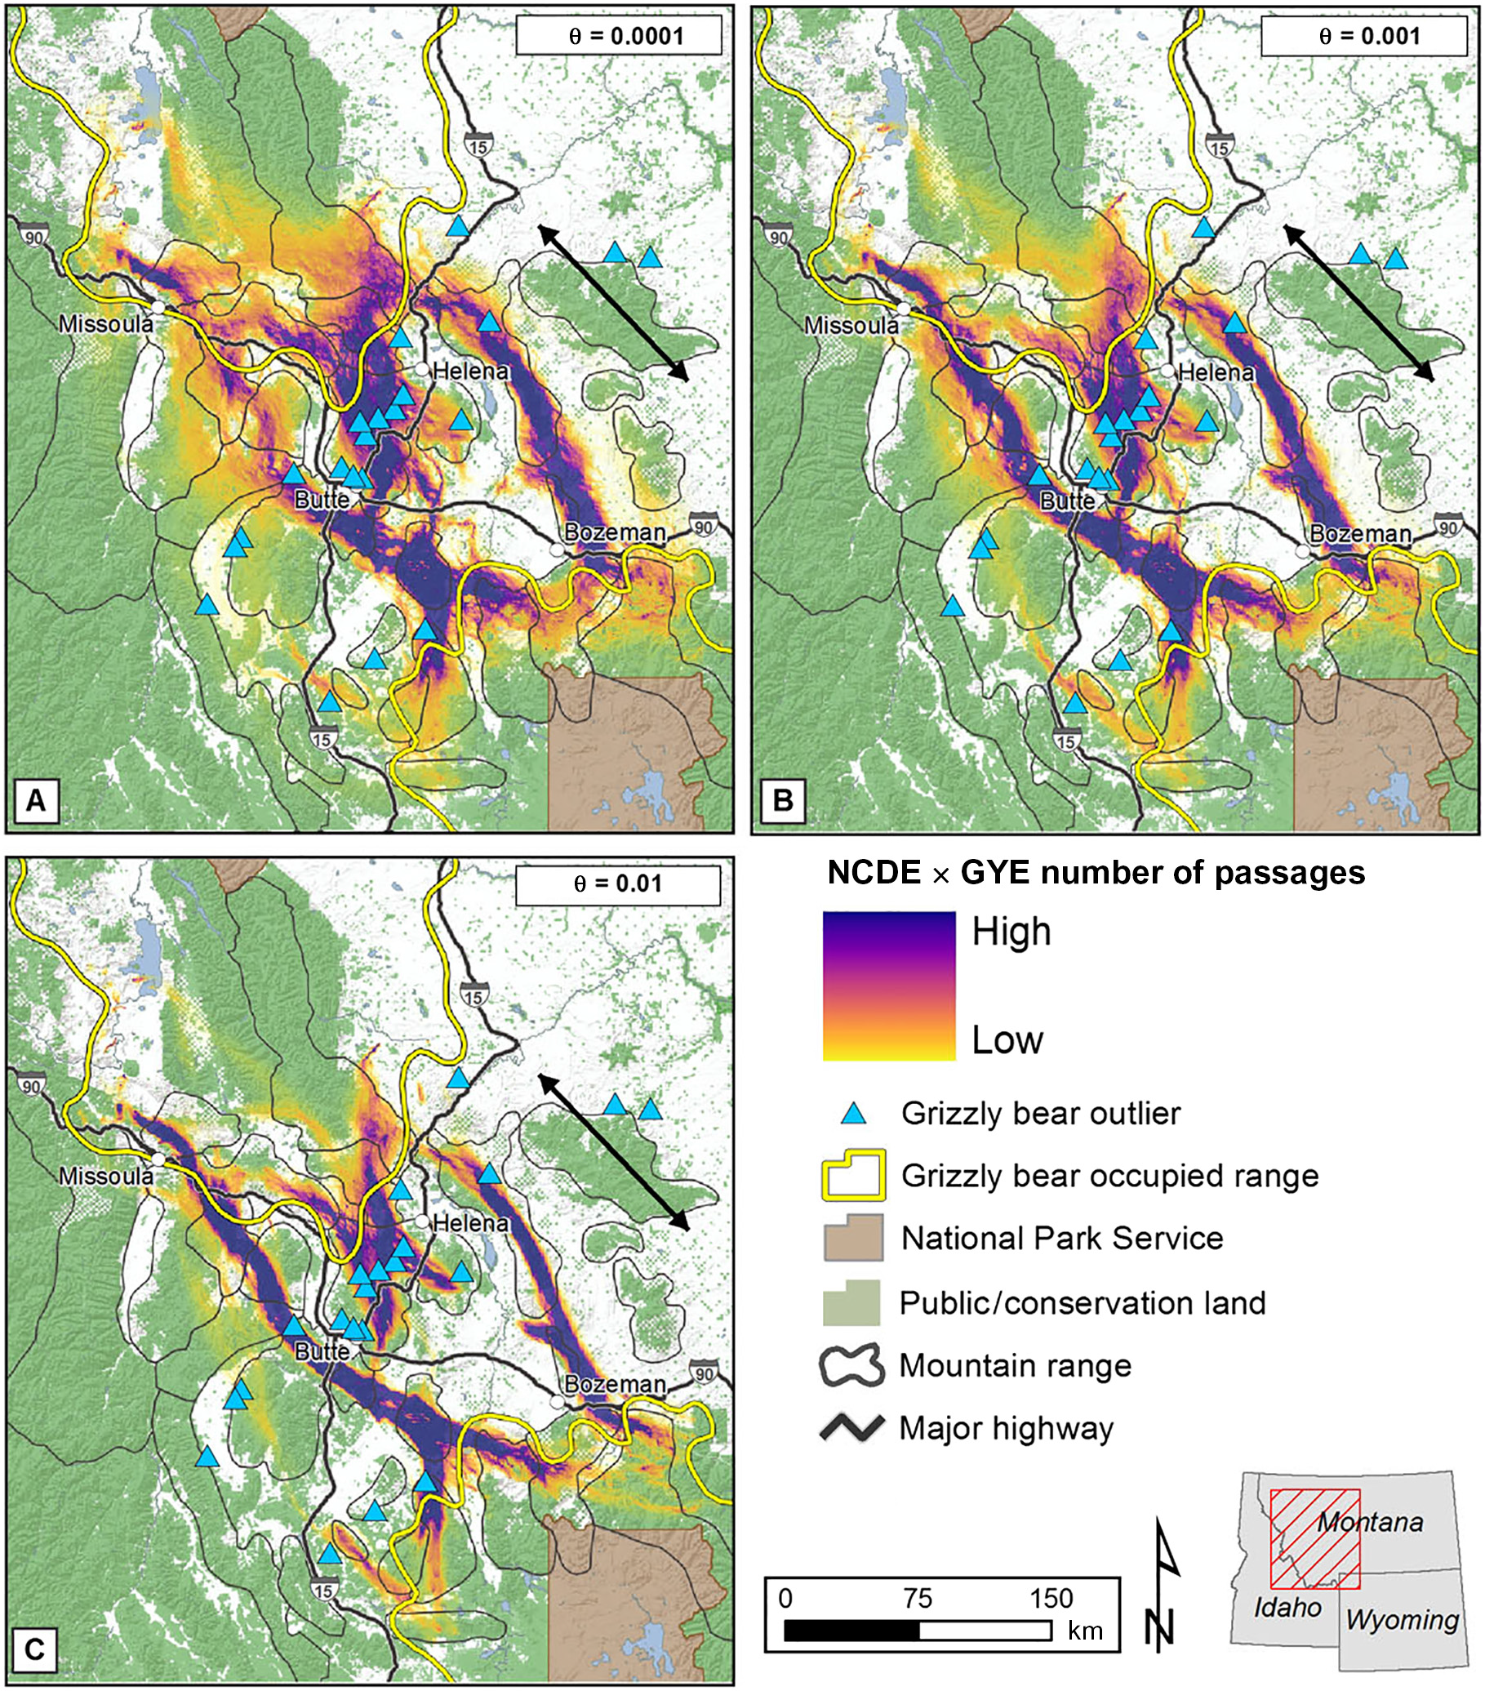
Fig. 4. Intersect of randomized shortest path (RSP) predictions
of male grizzly bear movements between the
Northern Continental Divide Ecosystem (NCDE) and Greater
Yellowstone Ecosystem (GYE), 2000–2015. Color gradient is
based on multiplication of cumulative values of RSPs for
100 pairs of origin–destination nodes for
each population (Figs. 2, 3). Three levels of h are shown,
representing different trade-offs between exploration
and optimal exploitation of the landscape:
h = 0.0001, (B) h = 0.001, and (C) h = 0.01.
Locations of 21 confirmed records of grizzly bear presence
are shown as blue triangles. Black arrow indicates
direction of paths.
Occupied range based on data through 2014
(Bjornlie et al. 2014, Costello et al. 2016).
❖ www.esajournals.org 11 October 2017 ❖
Volume 8(10) ❖ Article e01969

Slide 8
Connectivity in Forest Planning
Landscape connectivity is the relative degree
with which one landscape component (such as an ecosystem) is ecologically connected to other components.
The 2012 Planning Rule defines connectivity as: “Ecological conditions that exist at several spatial and temporal scales
that provide landscape linkages that permit the exchange of flow, sediments, and nutrients; the daily and seasonal
movements of animals within home ranges; the dispersal and genetic interchange between populations;
and the long distance range shifts of species, such as in response to climate change. ” (219.19).
The 2012 Planning Rule requires consideration, planning and management for ecological connectivity. It includes
explicit requirements for maintaining or restoring ecological connectivity on national forest lands and for facilitating
connectivity planning across land ownerships. These may be the first such requirements in the history of
U. S. public land management (Haber and Nelson 2015b).

Slide 9
The Forest Service Strategic Framework for Responding to Climate Change (The Roadmap), introduced in 2008
in response to the USDA 2010-2015 Strategic Plan, is another program that includes
“development of wildlife corridors to facilitate migration” as a strategy to address climate change effects.
This framework is described in the ‘National Roadmap for Responding to Climate Change’
USDA Forest Service 2011: www.fs.fed.us/climatechange/pdf/Roadmapfinal.pdf ). One of the ‘immediate initiatives’
in the roadmap is connecting habitats to improve adaptive capacity by:
Collaborating with partners to develop strategies that identify priority locations for maintaining and
restoring habitat connectivity.
Seeking partnerships with private landowners to provide migration corridors across private lands.
Removing or modifying physical impediments to species movement most likely to be affected by climate change.
Managing forest and grassland ecosystems to reduce habitat fragmentation.
Continuing to develop and restore important habitat corridors for fish and wildlife.

