Slide 1
MVP Coating and Other Safety Issues
Roberta Bondurant
Preserve Bent Mountain
Protect Our Water, Heritage Rights Coalition, CoChair
November 2022

Slide 2
MVP Coating+ UV + Geohazards=Catastrophe
-MVP Senior VP-Engineering Robert Cooper testified Jan 2018: More than 1 yr. in sun(UV light)and other elements degrades coating, causing corrosion. Industry (NAPCA) standard is half that exposure , at 6 months.
-October 2018: Manufacturer 3M Material Declaration: FBE “resists degradation” under “normal” environmental conditions. Removal of the 1-3 mil “chalked” outer layer prompts further “photodegradation…and the pitting gets deeper…” This phenomenon is common to all FBE coatings “designed only for below ground use… ” (Coulson & Ferguson, Journal of Corrosion Management, Issue 153, Jan/Feb 2021. (25.4 microns per year =1 mil.)
-MVP pipe coated 2016-17, stored in yards, per MVP testimony Jan 2018. MVP loaded pipe to sites in 2018-- even as 4th Circuit considered permits…and continued moving pipe to sites through Sept 2021, in absence of permits.
-Risks to pipe: exposure to UV and Appalachian sun, heat, humidity, rain, standing water. There are 429 remaining “crossings”-- (460 water bodies and 183 wetlands)(per FERC data; roanoke.com, par 24, 10/25/22.)
-Risks to people and environment: Coating damage, corrosion, steep slopes, in heavily-documented, landslide-prone soils and earthquake-prone zones combine to promise catastrophic explosions. MVP crosses 75.4 miles of steep slopes(30%-50%) nearly one fourth of its length, and 34.12 miles at greater than 50% slope. (J. Hileman PhD., Acc. No 20200909-5054, Table 1, from FERC FEIS Appendix K.)

Slide 3
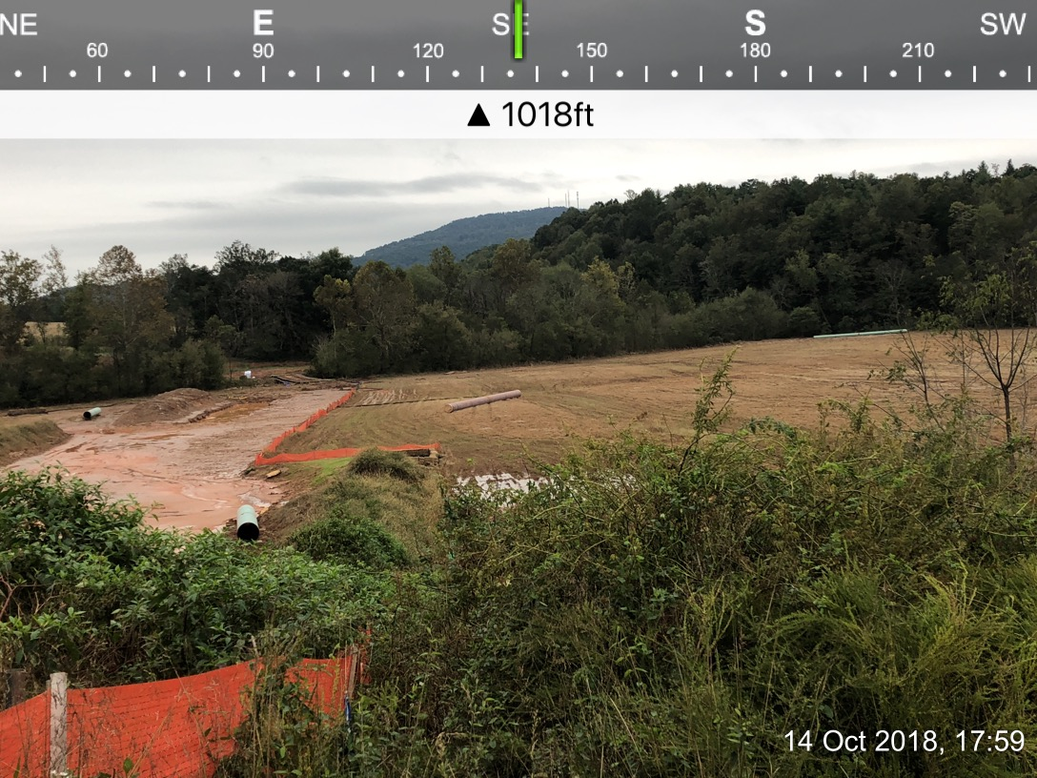
1
Franklin County Farm /MVP ROW after Storm Michael Oct.11.’18. MVP rushed construction across floodplain, failing to secure freshly dug ROW and trenches –and pipe. Three-and four -piece pipes floated hundreds of feet off-ROW into field and to the banks of the Blackwater River.

Slide 4
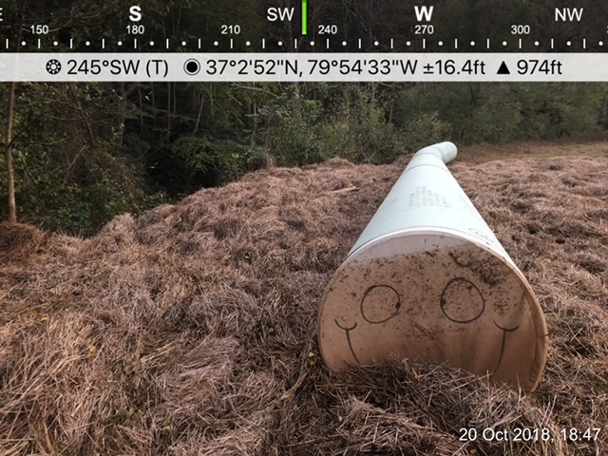
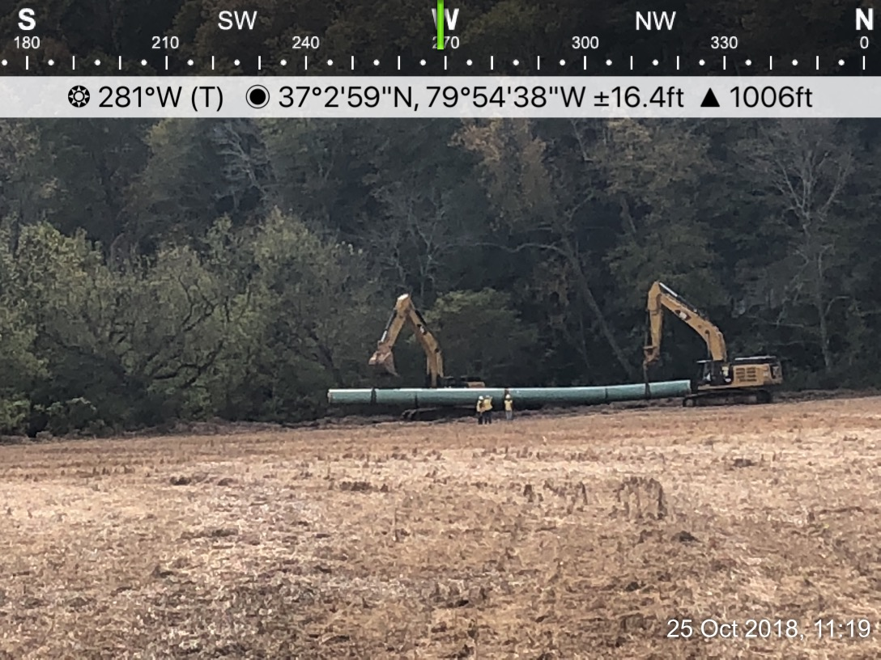
2
3
“3-joint, four-piece pipe , hauled back to ROW., by cranes. 2016 coating is beyond industry standard 6 months exposure to environment. Additional stresses include water inside and out, torque on welds, crackling, separation of coating in pipe movement and lifting, abrasion.

Slide 5
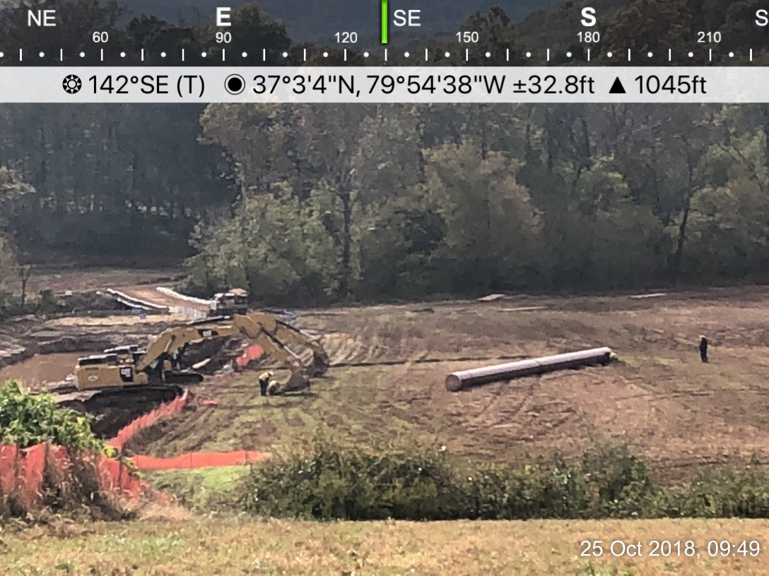
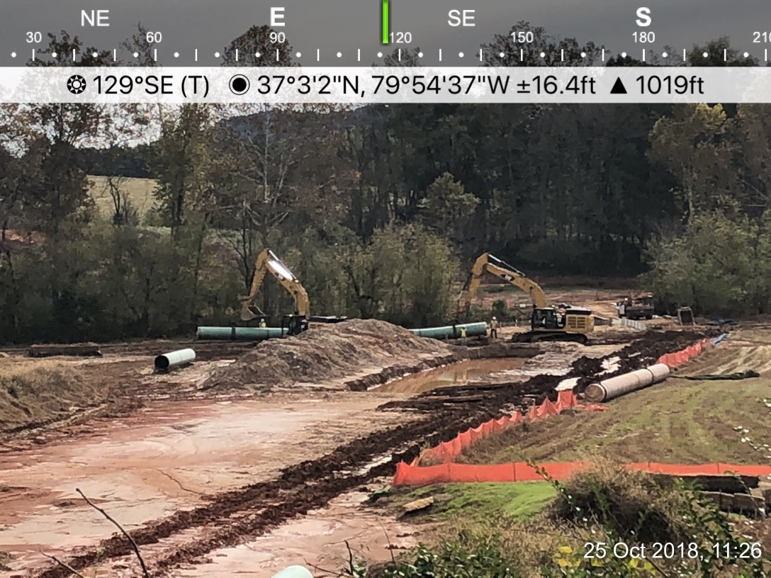
4
5
“Red” coated, 3-piece pipe dragged across ground back to ROW; four piece carried by crane to streamside. Note open trench, attached pipe under water, MVP pumped the open, watery, muddy trench Sept. 3,2019, and capped pipe --after a year submerged.

Slide 6
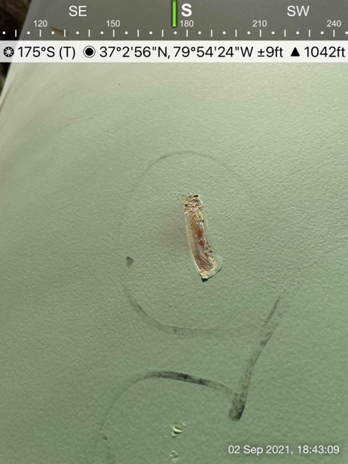
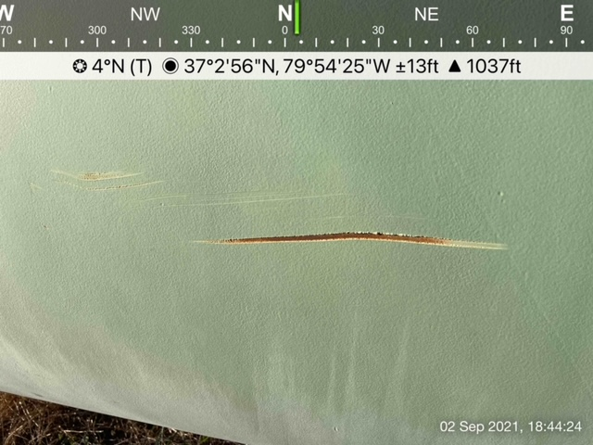
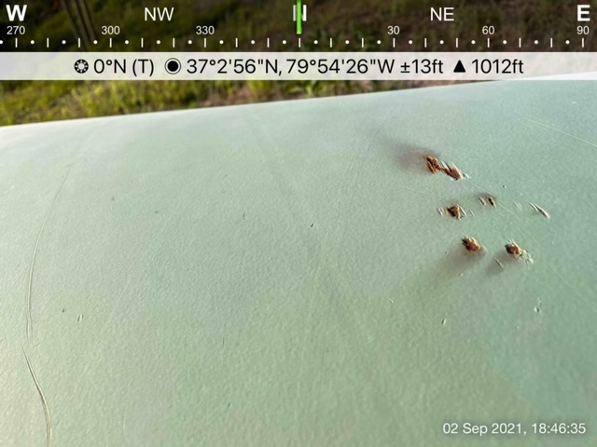
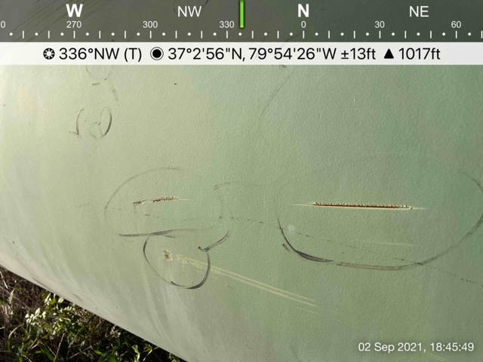
6
7
8
9
10
Gouges, pock marks, numerous pipes 2016, 2017 old pipe coating exposed to elements, on site since 2018. A Roanoke Times report September 3,2022 indicated that MVP has never rejected a pipe on site by way of a “holiday detector”—a hand-held, battery- operated wand, which inspectors wave over the pipe before lowering it in the trenches for burial. ( p. A.4, column 2, by Laurence Hammack.) See next two pages.

Slide 7
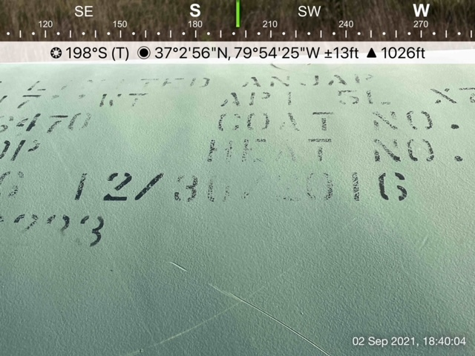
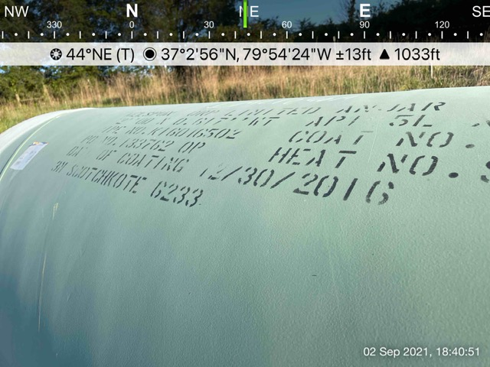
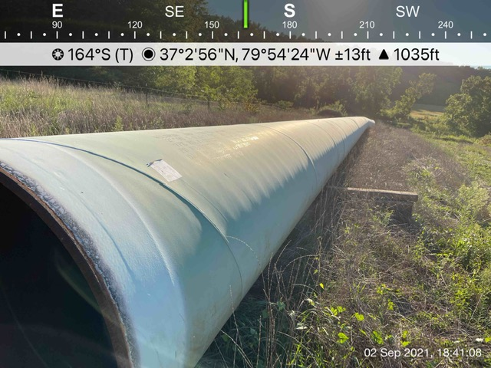
11
12
13
Observers report no pipe coated after 2017. By industry standards, 2016 pipe that was buried in 2018 was likely overexposed to UV.

Slide 8
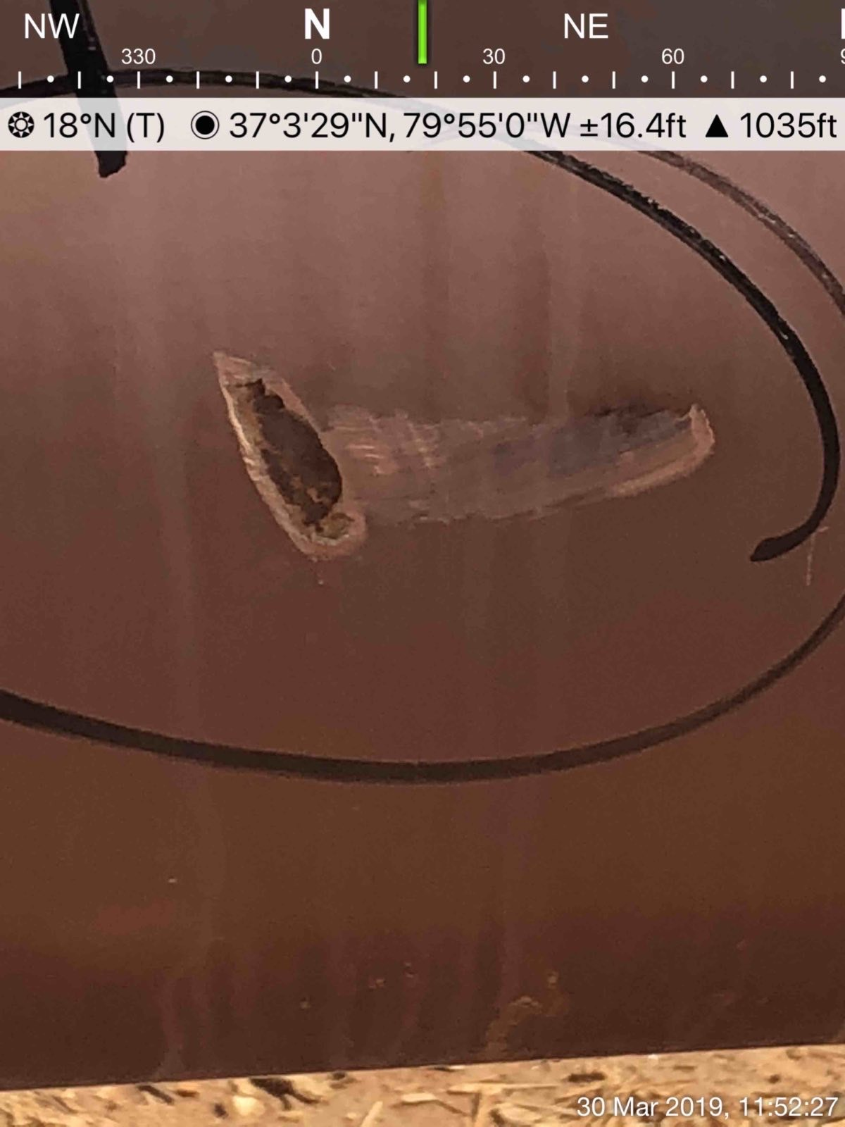
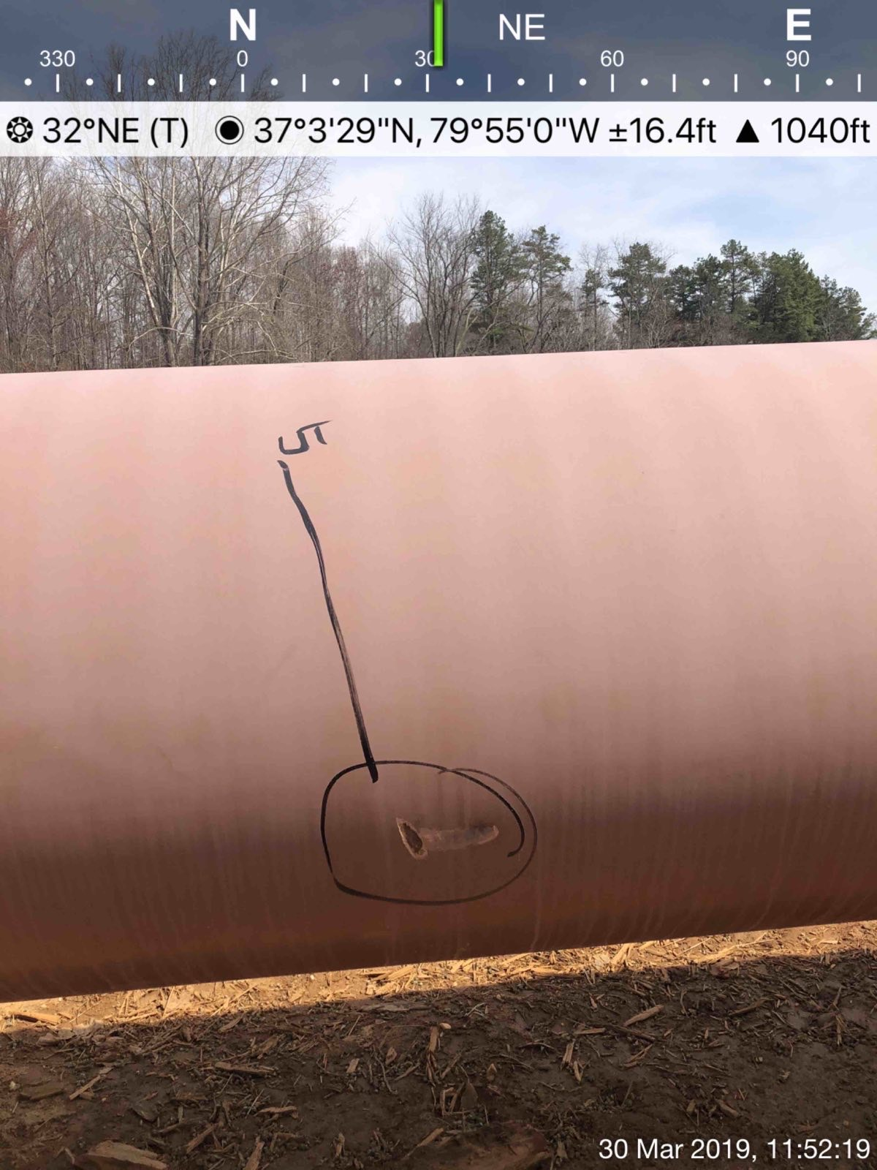
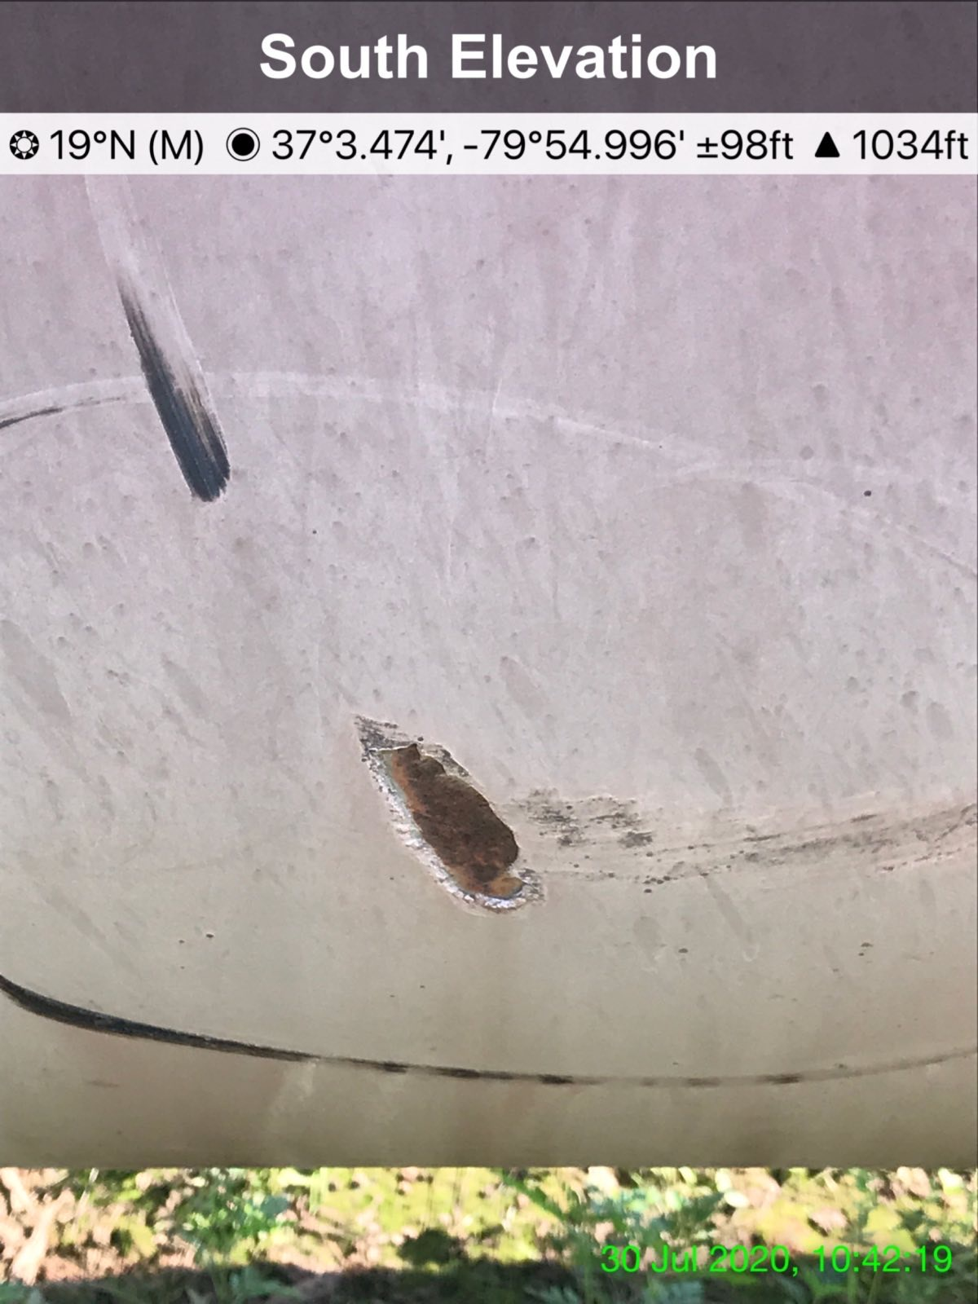
14
15
16

Slide 9
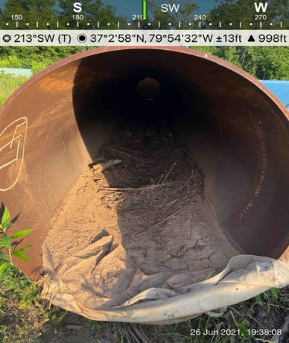
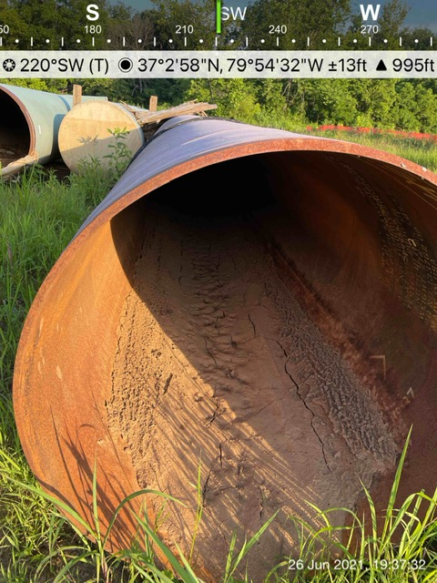
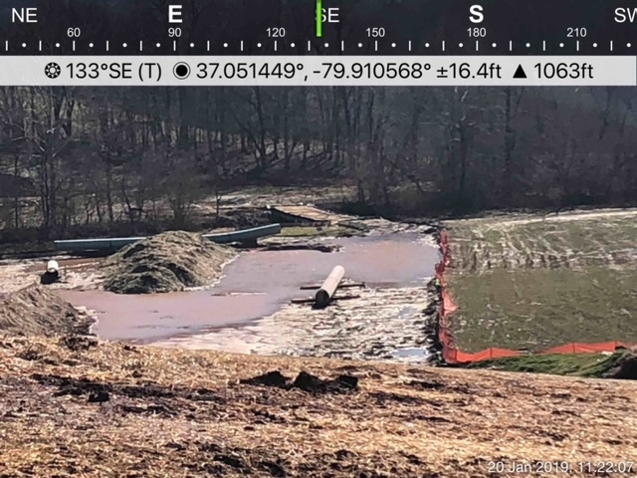
16
17
18
19
Three- and four-piece strings of 2016 – coated pipe, uncapped and corroding from the inside, floated October 11, 2018 across this known floodplain in well- predicted Tropical Storm Michael. Loss of MVP-disturbed earth creates ponds along the ROW.

Slide 10
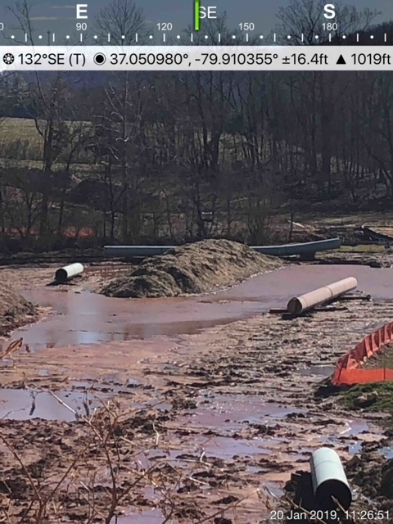
20
Photo January 2019. Pipe coated in 2016, stored in yards, then on Row from 2018-present. Stored proximate to Little Creek/Blackwater River, impacted by southern UV, heat/humidity, repeat storms. Water exposure inside and out.

Slide 11
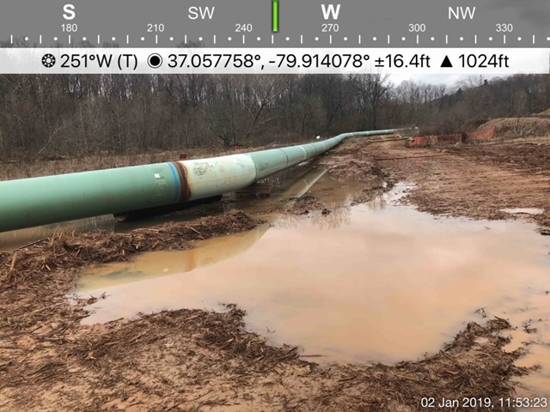
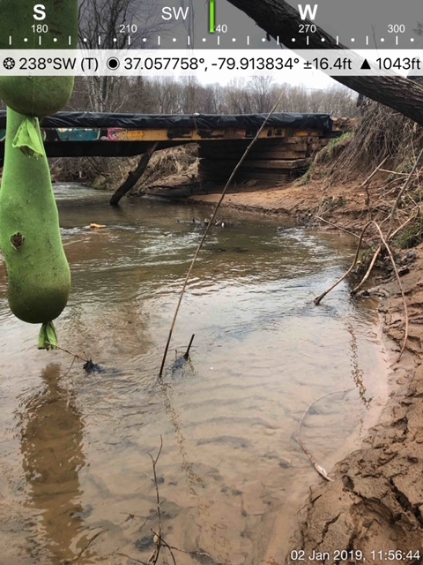
21
22
2016-17 coated pipe runs parallel to Teel and Little Creeks. Stream bank erosion and instability exacerbate the risk of long-degraded pipe coating and other damage. Timber mat bridge crossing shows further MVP impacts -- silt sock, other construction refuse in streams, severe sedimentation to stream bottom once documented as suitable Roanoke Logperch habit.

Slide 12
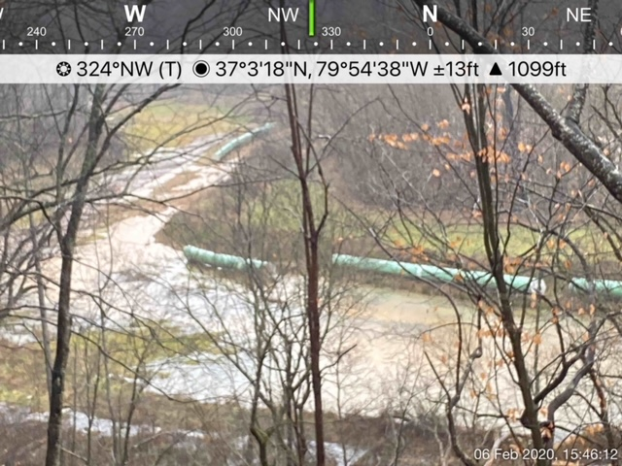
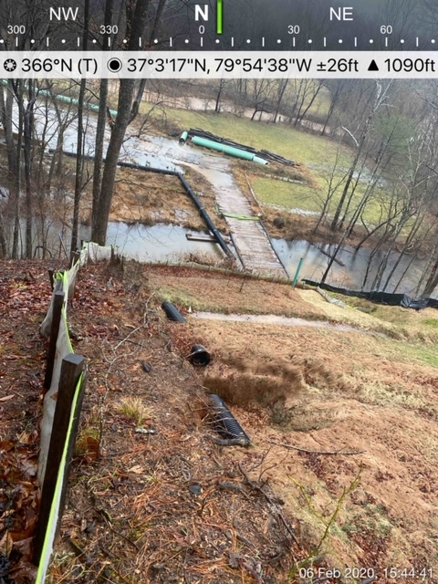
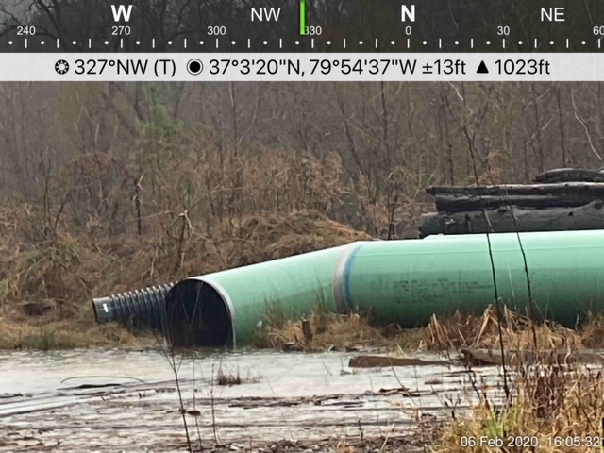
23
24
25
2016/17 old-coated pipes lay in water, below steep slope, in former bottomland- turned –muddy, ponded, MVP ROW, where crews loaded pipe to sites in 2018. Note absence of wooden “cribs” suspending pipe above ground.

Slide 13
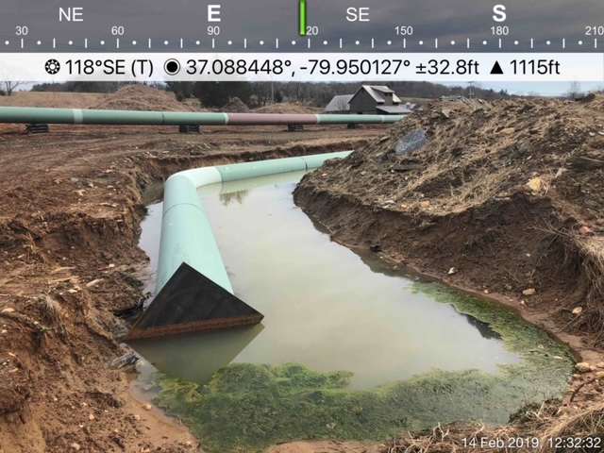
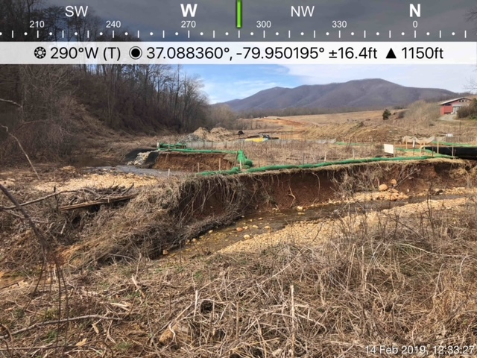
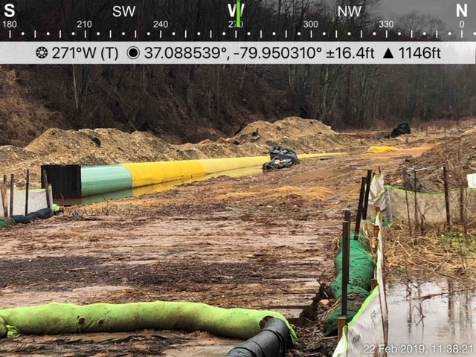
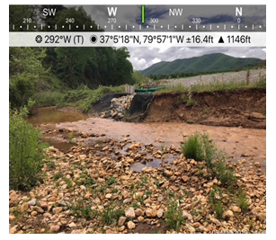
26
27
Trenching impacts to soil and pipes: Witnesses describe these pipes with one end welded to adjacent pipe and buried , and opposite ends floating in trenches--- with water levels that rose and fell by up to two feet, from July 2018 through September 2019--when MVP pumped out the muddy trench and buried the long- exposed pipes. Note stream bank erosion/collapse.-threatening pipe stability.
28
29

Slide 14
30
Threats of pipe instability increase exponentially with MVP’s creation of a muddy pool on the ROW over buried pipe (See white pipe and orange ribbon,, denoting centerline) Further impacts of MVP’s ravage of upstream waters are seen in extreme scour/bank collapse of Teels Creek, just yards from the pipe in trench.

Slide 15
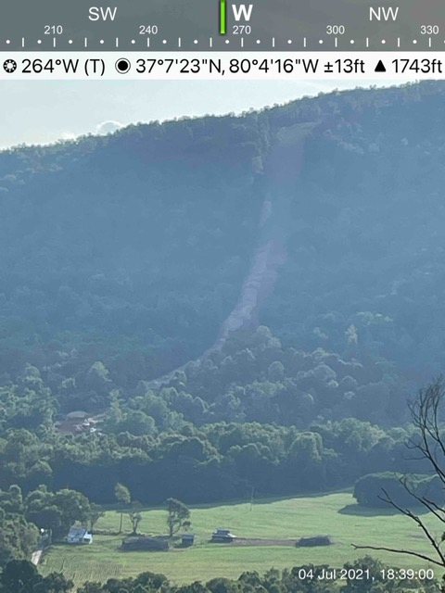
31
MVP slope at Adney Gap Virginia. Hairpin turn at bottom, the ROW cuts closely behind family home, lower right, crossing road, creek— and up a matching, steep slope. Steep slopes, highly erodible, landslide-prone soils, long-documented seismic zones with recent and regular earthquake activity compound explosion threat.

